Slide 1
RailGuard
A Real-Time IoT-Based Railway Gate Automation and Alert System
AKRITI KUMARI (220102026)
AYUSH KUMAR (220102038)
YASH GOSWAMI (220102044)
Supervised By-
Dr. Ramesh Ch. Mishra
&
Dr. Ngasepam Monica Devi
Notes:
Good morning, esteemed Professors, Dr. Mishra, and Dr. Monica Devi.
I am Yash Goswami, and alongside my colleagues, Akriti Kumari and Ayush Kumar, we are excited to present our solution to a critical national safety issue: RailGuard—A Real-Time IoT-Based Railway Gate Automation and Alert System.
We are grateful for the guidance and supervision provided by Dr. Ramesh Ch. Mishra and Dr. Ngasepam Monica Devi throughout this project.

Slide 2
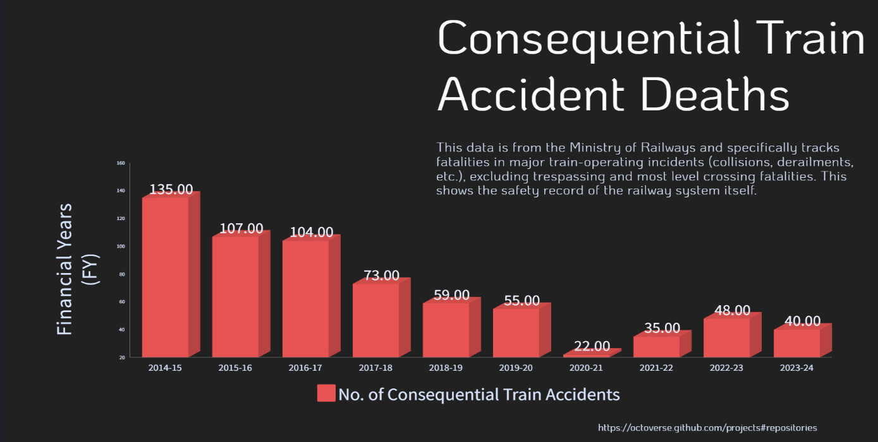
Consequential Train Accident Deaths
[1] [2] [3]
Notes:
"To understand the context of our work, we first look at the official railway safety record.
This graph shows the trend in Consequential Train Accidents—those caused by serious operational failures like collisions and derailments—over the last decade. This data, sourced from the Ministry of Railways, shows the safety record of the system itself.

Slide 3
Literature Survey
Automatic Railway Gate Controlling and SmartSystem of Railway Gate Crossing using IoT (By: Akash Waghmare, Himanshu Ghate, Gaurav Maske, Pradarshit Kurzekar) (Published in: Recent Trends in Information Technology and its Appli-cation, Vol. 3, Issue 1, 2020)
Pros: Good connectivity in urban areas
Cons: Heavily internet dependent, unreliable in rural settings
Automatic Railway Gate and Crossing Controlbased Sensors & Microcontroller (By: Ahmed Salih Mahdi Al-Zuhairi) (Published in: International Journal of Computer Trends and Technology,Vol. 4, Issue 7, July 2013)
Pros: Reliable detection
Cons: No remote access or alert capabilities
Smart Railway Track and Crossing Gate Secu-rity System Based on IoT (By: Mir Sajjad Hussain Talpur et al.) (Published in: International Journal of Advanced Trends in Computer Sci-ence and Engineering, Vol. 10, No. 2, 2021)
Pros: High accuracy detection
Cons: Complex setups, high cost, maintenance issues
Notes:
Before designing RailGuard, we reviewed existing solutions, which highlighted three main gaps:
IoT Gates with NodeMCU: These systems, while functional, are often heavily internet dependent and prove unreliable in the remote, rural settings where they are most needed.
Magnetic Sensors: These offer reliable train detection but lack any remote access or alert capabilities to warn drivers and pedestrians.
Force, Vibration, and Laser Sensors: While providing high accuracy, the resulting complex setup and high cost lead to significant maintenance issues, making them impractical for widespread, low-cost deployment.
This survey confirmed that a gap exists for an affordable, reliable, cloud-integrated solution tailored specifically for the harsh operating environment of rural India.

Slide 4
Motivation: Why RailGuard?
Current Issues
Lack of Automation
Most rural crossings rely on manual gates, increasing accident risks.
Human-operated systems vulnerable to fatigue and error
Staff shortages leave many crossings temporarily unmanned
No backup systems during operator absence or emergencies
Human Error & Miscommunication
Gatekeeper mistakes and poor inter-station coordination cause frequent accidents
Communication gaps between railway control rooms and crossing operators
Delayed emergency response times compromise safety
Manual systems lack fail-safe mechanisms
No Real-Time Alerts
Pedestrians and drivers remain unaware of approaching trains
Zero advance warning systems for nearby communities
Limited or no communication between train operators and crossing management
Absence of digital platforms for public safety information
Notes:
Our motivation stems from three critical, persistent issues on the ground:
Lack of Automation: Most rural crossings still rely on manual gates, increasing accident risks. These human-operated systems are vulnerable to fatigue and error.
Human Error & Miscommunication: Mistakes by gatekeepers and poor coordination cause frequent accidents, leading to delayed response times in emergency situations.
No Real-Time Alerts: Current infrastructure offers limited communication. Pedestrians and drivers remain unaware of approaching trains until the last moment, and there is limited communication between train operators and crossing management.

Slide 5
Problem Statement
Railway Crossing Safety Crisis in Rural Areas
61% of railway accidents in rural areas occur at unmanned or manually operated crossings. [ResearchGate, citing Indian Railways Annual Report and Accounts 2014-15]
Average response time at manual gates exceeds safety thresholds by 20 seconds. [Transportation Research Board]
95% of accidents attributed to human error and miscommunication. [ResearchGate, citing national data]
Our solution
RailGuard: Intelligent IoT-Based Railway Gate Automation
Automated Detection: Multi-sensor system (3 ultrasonic sensors) for comprehensive train tracking
Predictive Intelligence: Real-time speed calculation and ETA prediction
Mobile Alerts: Push notifications to users within 1-2 seconds of detection
Cloud Integration: Firebase-based logging for analytics and monitoring
Notes:
This brings us directly to our Problem Statement: The safety crisis at railway crossings in rural areas is acute, driven by verifiable failures in control and management.
The numbers are alarming:
Sixty-one percent (61%) of railway accidents in rural areas occur at unmanned or manually operated crossings.
The average response time at manual gates exceeds safety thresholds by 20 seconds.
And finally, ninety-five percent (95%) of accidents are attributed to the human factor, categorized as human error and miscommunication.
Our solution, RailGuard, is designed to directly address this crisis. We have developed an affordable, reliable IoT-based system to eliminate human error and provide real-time, life-saving alerts at these underserved rural crossings.
To walk you through exactly how we achieved this and the system's architecture, I would like to now hand over the presentation to my groupmate, Ayush Kumar.

Slide 6
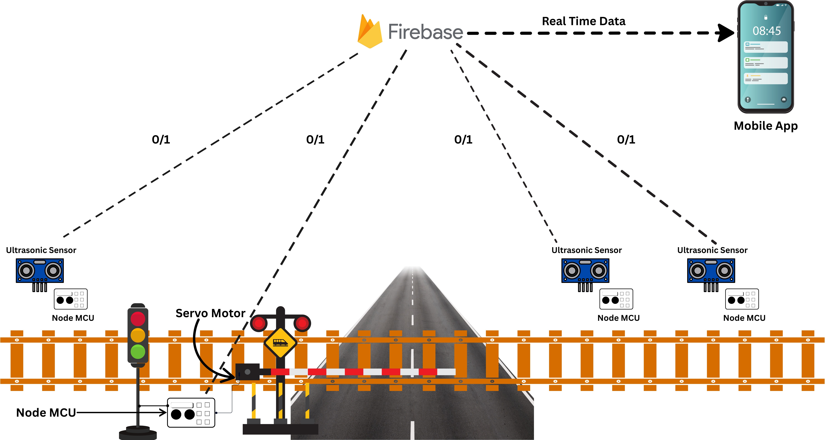
System Overview
Automated Railway Gate Control using ESP32, Firebase, Web Dashboard.

Slide 7
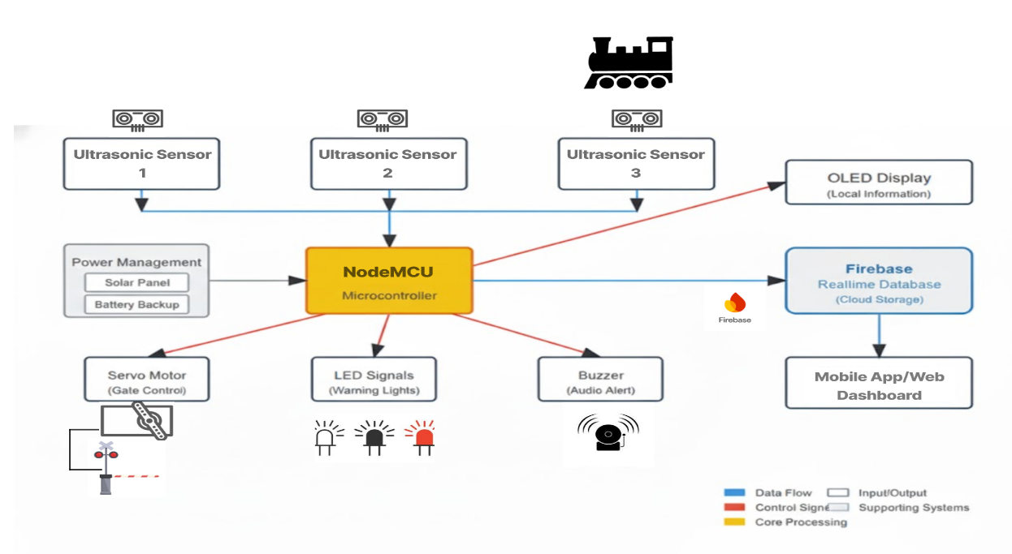
System Architecture
Notes:
Inputs: It takes data from three Ultrasonic Sensors to detect the train. It's supported by a Power Management system, which is designed with a Solar Panel and Battery Backup in mind, making it perfect for rural areas.
Outputs: Now, what does the NodeMCU control? It sends a control signal to the Servo Motor to operate the gate. It also triggers the LED Warning Lights and an Audio Alert from a buzzer. We also have a small OLED Display for local information right at the crossing.
Cloud: Finally, the NodeMCU sends all this data to the Firebase Realtime Database, which acts as our cloud storage. This database is what syncs everything with the Mobile App and Web Dashboard that the public and administrators use.

Slide 8
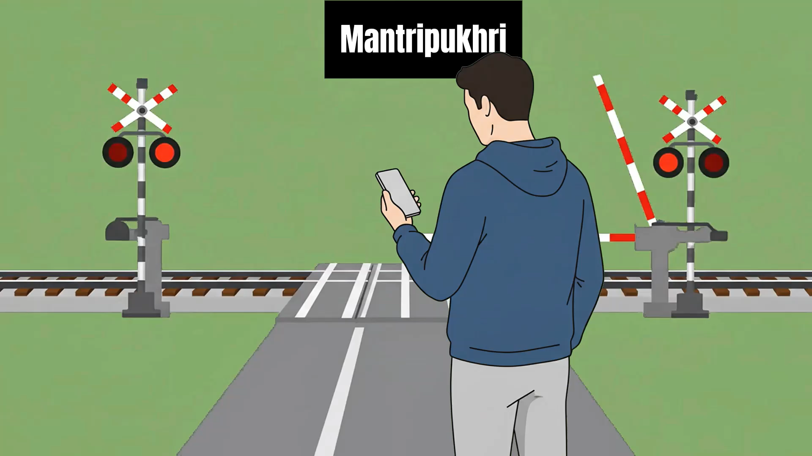
Visual Representation

Slide 9
Hardware Implementation
Hardware Components:
Testing Results
Prototype hardware and logic tested successfully in lab; gate response is immediate, with no mechanical delay.
Wokwi simulation validated sensor, gate, and system logic. Observed delay of 1–2 seconds (hardware) and 3–4 seconds (Wokwi) applies only to real-time data updates shown in the app and web dashboard, not to physical gate operation.
No real railway testing yet. results based only on prototype and simulation.
Sensor 1 TRIG = D5, ECHO = D6 Used D5 (GPIO14) and D6 (GPIO12), which are standard digital pins on the ESP8266. These pins are reliable for fast pulse generation and accurate timing required by ultrasonic sensors.
Sensor 2 TRIG=D7, ECHO=D8 D7 (GPIO13) and D8 (GPIO15) chosen due to their stable I/O characteristics for mid-point distance measurement. Not used for critical system boot, making them safe for sensor activation.
Sensor 3 TRIG = D1, ECHO = D2 D1 (GPIO5) and D2 (GPIO4) are standard, conflict-free digital outputs on ESP8266, often used for communication (e.g., I2C). Here, they provide good accessibility and timing for the gate sensor.
Servo Motor D0 (GPIO16) D0 is a safe boot pin, so using it for servo signal avoids interfering with WiFi or system start-up. It is not involved in flash operations, which makes servo start and sweep motion reliable.
Notes:
"Okay, so let's move on to the actual hardware implementation—the physical components we used to bring this system to life.
As you saw in the architecture diagram , the heart of our prototype is the NodeMCU (ESP8266) microcontroller. This is the 'brain' that connects to all the other parts and to the Wi-Fi.
For detection, we are using three Ultrasonic Sensors. We were very specific about our wiring, using standard digital pins like D5, D6, D7, and D8 for the sensor triggers and echoes to ensure we got reliable, fast timing.
To control the gate, we're using a standard Servo Motor. We connected this to pin D0. We chose this pin specifically because it's a safe boot pin, which means it doesn't interfere with the Wi-Fi or the system starting up, making the servo's motion very reliable.
On the right side of the slide, you can see the actual physical prototype we built, showing how these components—the NodeMCU, the sensors, and the servo—are all wired together on the breadboard. This is the exact setup we used for our successful lab tests.
Now, let's talk about our testing results so far.
We've completed two main phases.
First, we built a hardware prototype and tested it in our lab. We were very happy to see that the physical gate response is immediate, with no mechanical delay.
Second, we used a Wokwi simulation to validate the entire system's logic, including the sensors and the gate, and it all checked out.
One important thing we measured was delay. We did observe a very small delay—about 1 to 2 seconds on the hardware, and 3 to 4 seconds in the simulation. But I want to be very clear: this delay only applies to the real-time data updating on the app or the web dashboard. The physical gate operation itself remains immediate.
As a limitation, we want to be transparent that we have not conducted real railway testing yet. All our current results are based on this successful prototype and simulation phase

Slide 10
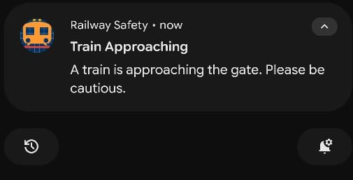
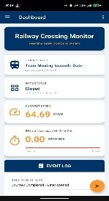
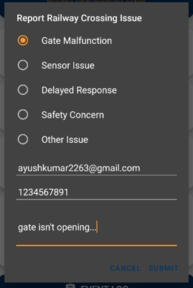
Mobile Application Features
Push Notifications
Sends instant “Train Approaching – Please be cautious” alerts to users, delivered within 1–2 seconds of detection.
Real-Time Dashboard
Live updates on train status, gate position (Open/Closed/Closing) and speed (km/h).
ETA countdown with a progress bar and event log with timestamps for full system transparency.
Issue Reporting Feature
Users can quickly report issues by selecting from the categories.
Captures contact details and sends automated email notifications to administrators for fast response.
Push Notification for approaching Train
Mobile App Dashboard
Issue Reporting Feature

Slide 11

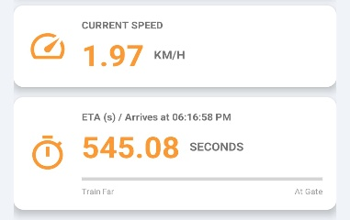
What Makes Our System Better?
Multi-sensor detection with speed and ETA
Real-time speed calculation using time differential between sensors enables precise monitoring of approaching train velocity.
System supports bidirectional detection, accurately recognizing train movement from either direction for enhanced safety.
Real-time data logging on Firebase cloud
Event logging with timestamps for analysis and improvement, capturing every key action (detection, gate status change, train passed).
Historical data allows for pattern recognition, maintenance planning, and long-term system optimization.
Automated uploads reduce manual intervention, supporting continuous system analytics with minimal operator effort.
Mobile/web dashboard for live public alerts
Visual alerts, countdown timers, and active notifications inform users about approaching trains and gate status in real time.
Estimated waiting time for road users clearly displayed, improving public planning and reducing congestion at crossings.
Sensor 1
Sensor 2
10km
Speed and ETA Interface

Slide 12
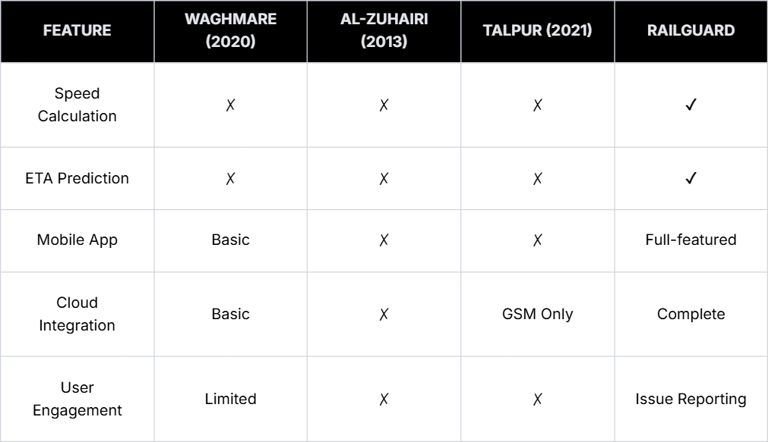
Comparative Analysis

Slide 13
Challenges and Solutions
➢ Sensor Sensitivity
Challenge: Ambient noise and uneven surfaces
Solution: Calibration, software filters, precise alignment
➢ Power Reliability
Challenge: Rural power outages
Solution: Solar backup provision, stable 5V 2A supply
➢ Network Connectivity
Challenge: Unstable Wi-Fi in remote areas
Solution: Retry mechanism, local event buffering (50 events)
Limitations (Current Version)
Firebase cloud dependency
Single communication channel (Wi-Fi)
Ultrasonic sensor range (~4 meters)
Weather sensitivity of sensors

Slide 14
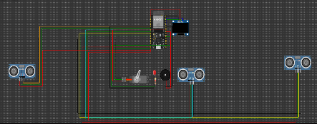
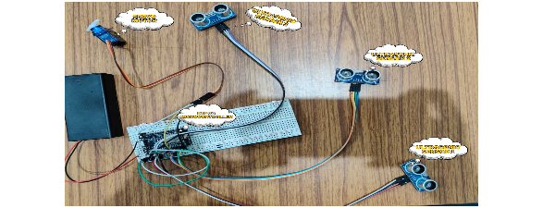
Results Summary
Phase 1 - Simulation (Wokwi) :
All core modules validated
Speed/ETA calculations accurate
Firebase connectivity confirmed
Phase 2 - Hardware Prototype :
Physical sensors operational
Gate control mechanism functional
Mobile app real-time sync successful
System responsive to varying speeds
Key Achievement :
Successfully transitioned from simulation to functional physical prototype with complete mobile app integration
Wokwi Software Circuit
Hardware Implemented Circuit

Slide 15
Future Improvements
Advanced Sensor Technology
LiDAR or infrared sensors for all-weather reliability
Camera integration (ESP32-CAM) for visual verification
Enhanced Connectivity
GSM module (SIM800L) for backup communication
Multi-network redundancy
Scalability Features
Multi-gate coordination system
Centralized dashboard for network-wide management
Integration with railway scheduling systems
Advanced Mobile Features
Historical data analysis and visualization
Customizable push notifications
Live train status maps

Slide 16
Conclusion
Key Innovations
Multi-sensor intelligence with speed & ETA prediction
Comprehensive Firebase cloud integration
Mobile-first approach with community engagement
Modular, scalable architecture
Real-World Impact
Addresses 70% of rural railway accidents
Eliminates human error in gate operations
Provides real-time alerts to stakeholders
Suitable for under-served rural areas
RailGuard represents a paradigm shift from passive manual crossings to intelligent, automated, community-engaged railway safety infrastructure.
Summary

Slide 17
Research and References
Reference Links
Lok Sabha/Rajya Sabha Reply (Digital Sansad). [1]
Press Information Bureau (PIB) Release. [2]
Rajya Sabha Reply (Digital Sansad). [3]
ResearchGate, citing Indian Railways Annual Report and Accounts 2014-15. [4]
Transportation Research Board. [5]
ResearchGate, citing national data. [6]
Research Papers
Automatic Railway Gate Controlling and SmartSystem of Railway Gate Crossing using IoT (By: Akash Waghmare, Himanshu Ghate, Gaurav Maske, Pradarshit Kurzekar) (Published in: Recent Trends in Information Technology and its Appli-cation, Vol. 3, Issue 1, 2020)
Automatic Railway Gate and Crossing Controlbased Sensors & Microcontroller (By: Ahmed Salih Mahdi Al-Zuhairi) (Published in: International Journal of Computer Trends and Technology,Vol. 4, Issue 7, July 2013)
Smart Railway Track and Crossing Gate Secu-rity System Based on IoT (By: Mir Sajjad Hussain Talpur et al.) (Published in: International Journal of Advanced Trends in Computer Sci-ence and Engineering, Vol. 10, No. 2, 2021)

Slide 18
Publications
Research Paper –
Ayush Kumar, Akriti Kumari, and Yash Goswami. "RailGuard: A Real-Time IoT-Based Railway Gate Automation and Alert System." (Ongoing Research Paper)
Under the Guidance of –
Dr. Ramesh Ch. Mishra & Dr. Ngasepam Monica Devi
Group Details –
Ayush Kumar
Akriti Kumari
Yash Goswami

Slide 19
Thank You!

